Slide 1



Stesimbrotus of Thasos (II)

Slide 2
Contents
Interpretations of On Themistocles, Thucydides, and Pericles
(I) A Political Pamphlet
(II) Between παιδεία (education and culture) and ἦθος (character)
(III) An Early Example of Greek Biography
(IV) Pamphlet Again?

Slide 3

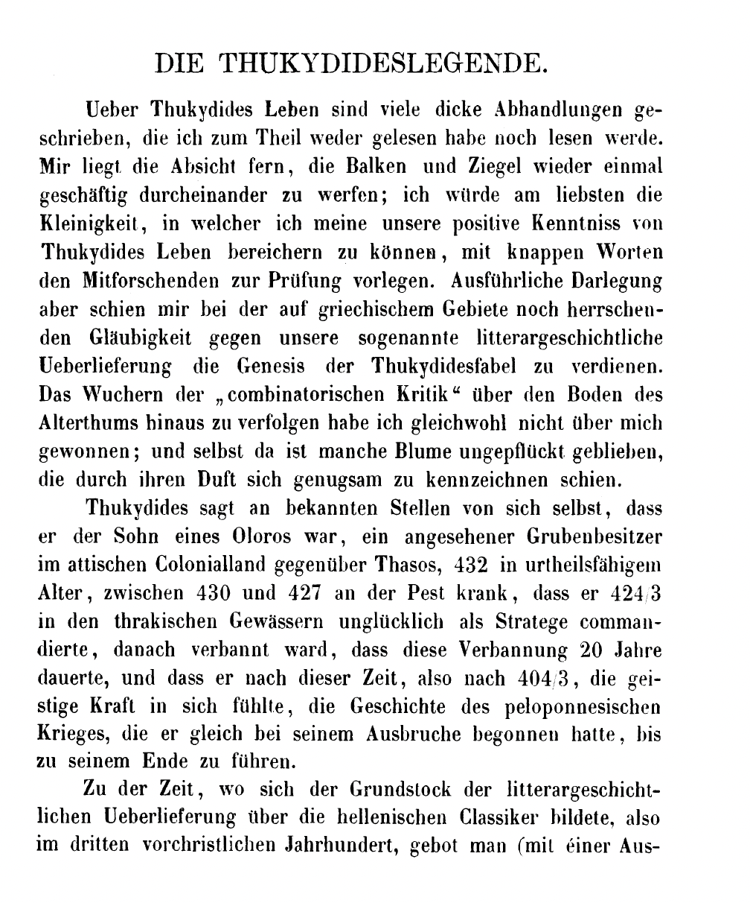
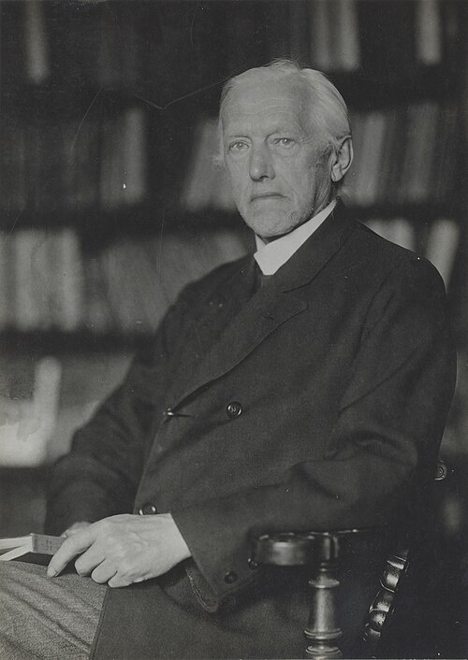
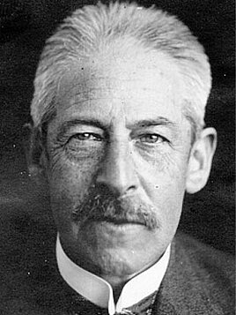
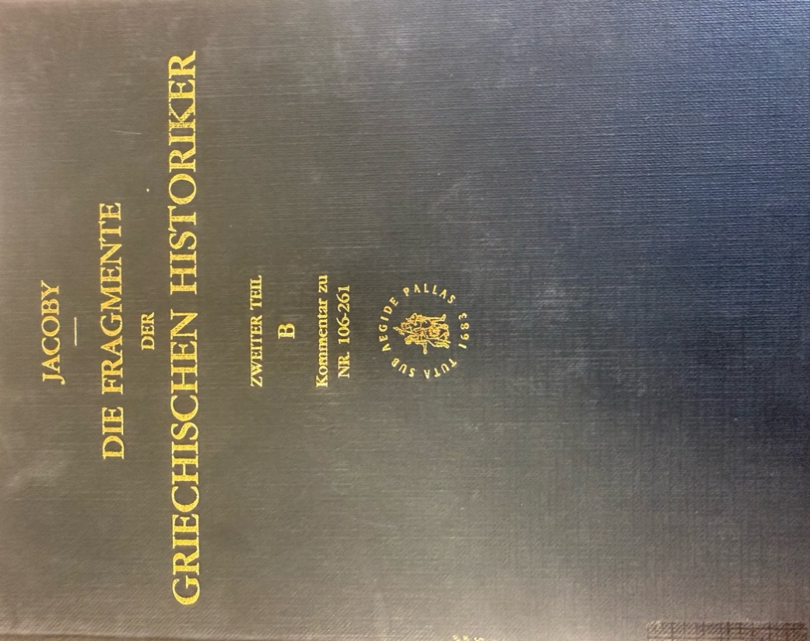
Interpretation of On Themistocles, Thucydides, and Pericles (I): A Political Pamphlet

Slide 4


Interpretation of On Themistocles, Thucydides, and Pericles (II): Between παιδεία (education and culture) and ἦθος (character)

Slide 5
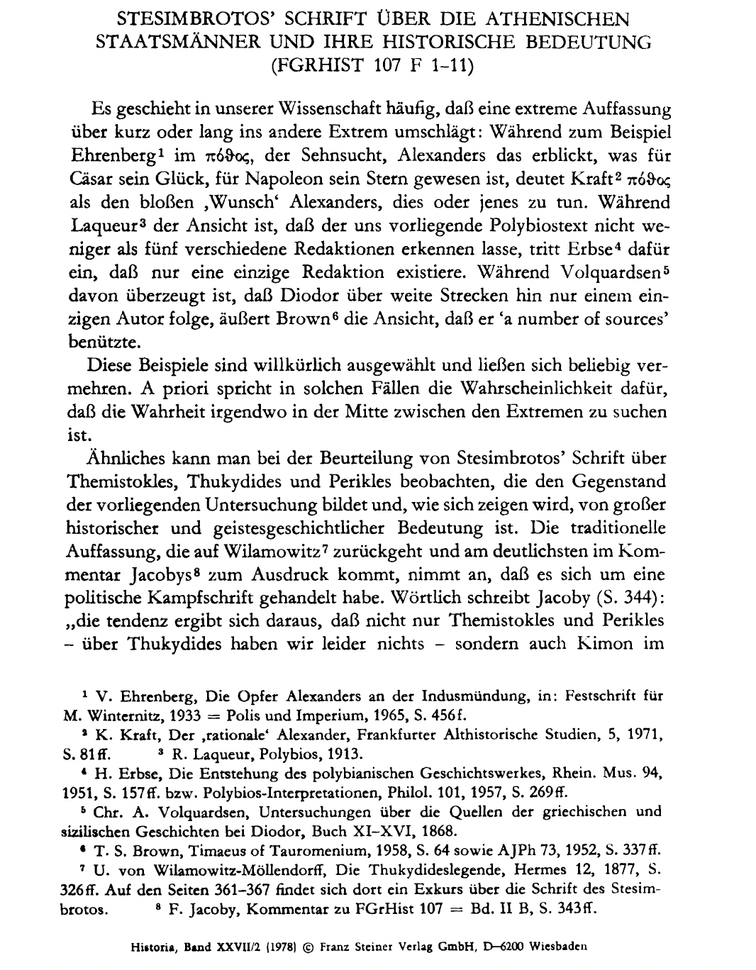
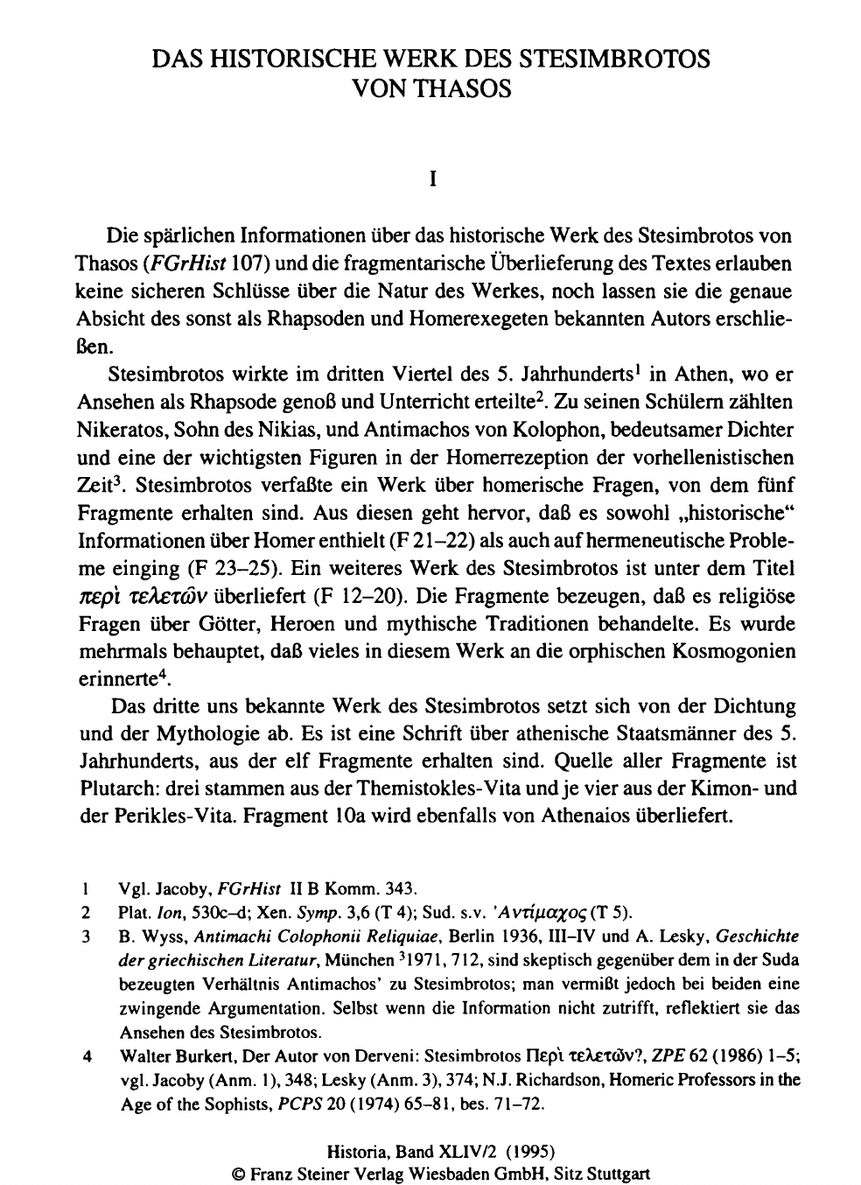
Interpretation of On Themistocles, Thucydides, and Pericles (III): An Early Example of Greek Biography

Slide 6
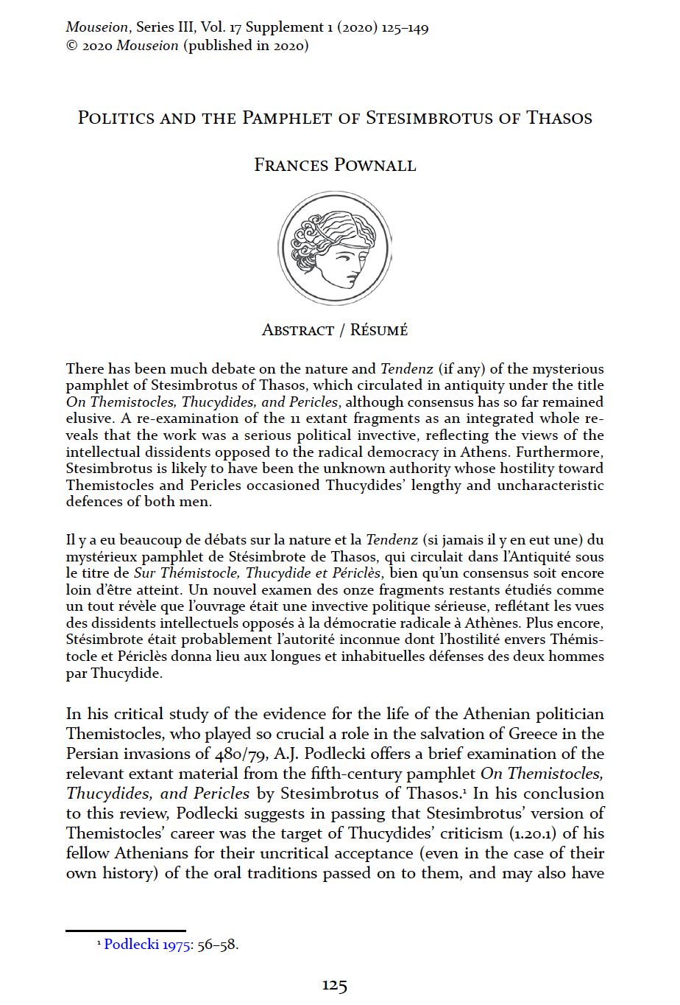

Interpretation of On Themistocles, Thucydides, and Pericles (IV): Pamphlet Again?

Slide 7
Thanks for your attention!
Contact: ruobingxian@fudan.edu.cn

